Slide 1

Discipline: Report to the School Board
October 10, 2024

Slide 2
Agenda
1
State Data
Disciplinary data suggests incidents are on the rise.
4
RECENT TRENDS
Some positive data points to review.
2
ACPS Data
Disciplinary data suggests the most severe and concerning behavior is decreasing, but others rising.
5
PRESENTATION SUMMARY
The data story.
ACPS
Elementary, Middle and High Data
It’s worth a look. Elementary level is struggling, then Middle while High is seeing a leveling.
3

Slide 3
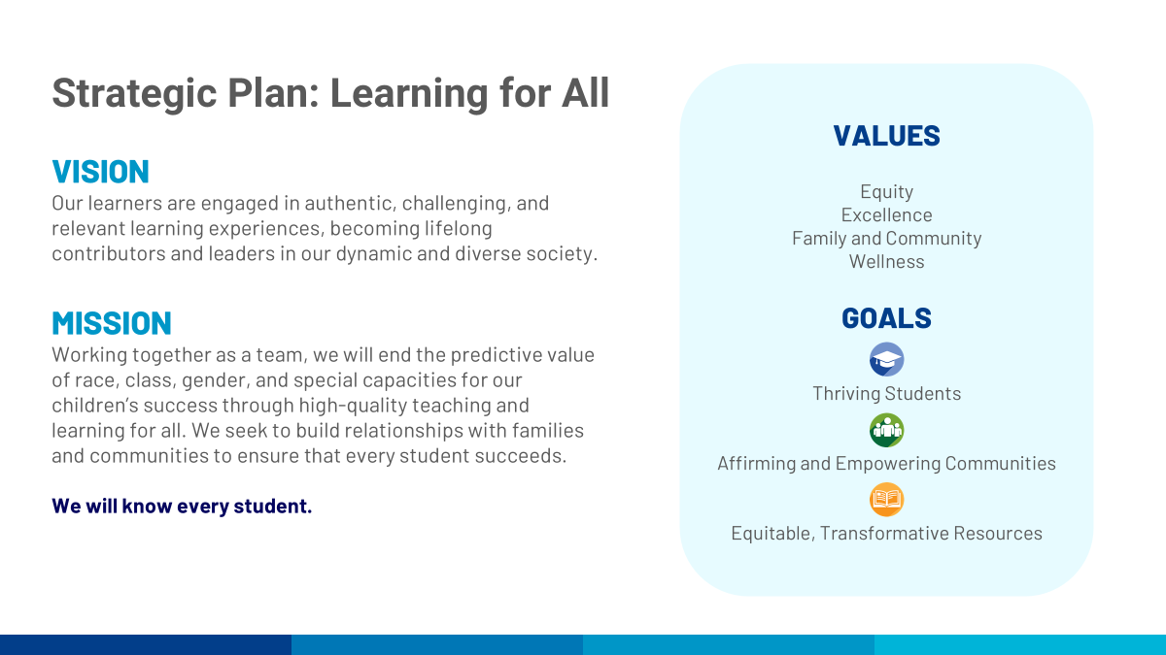

Slide 4
The Data Story

Slide 5
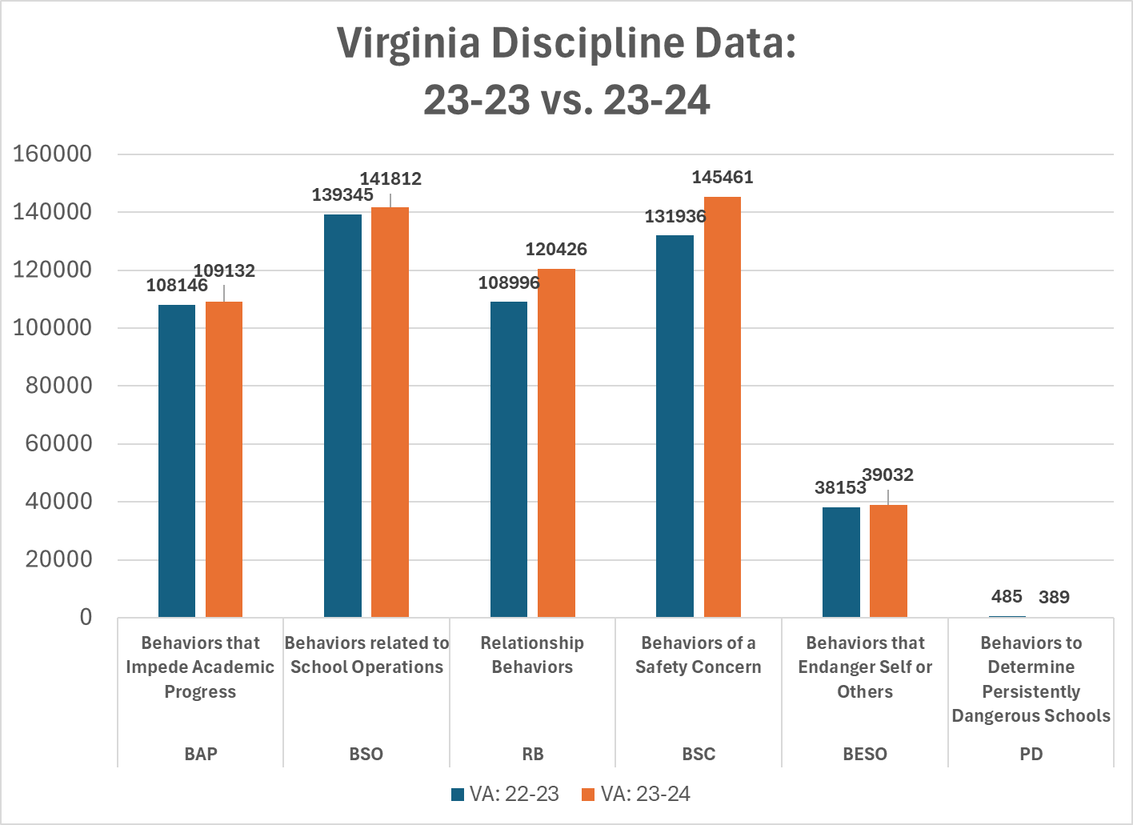

Slide 6
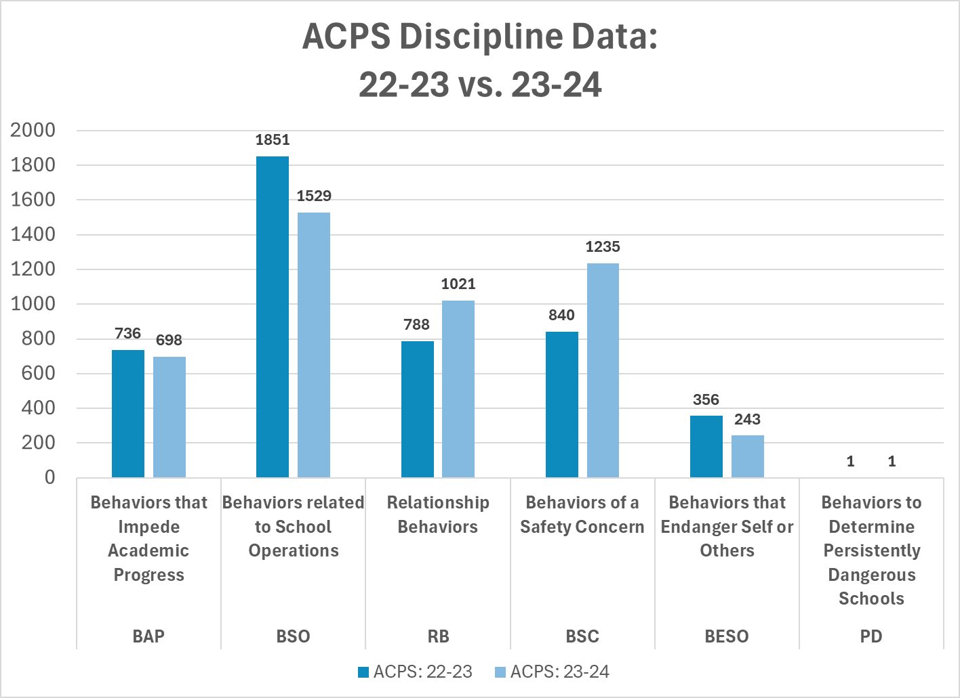

Slide 7
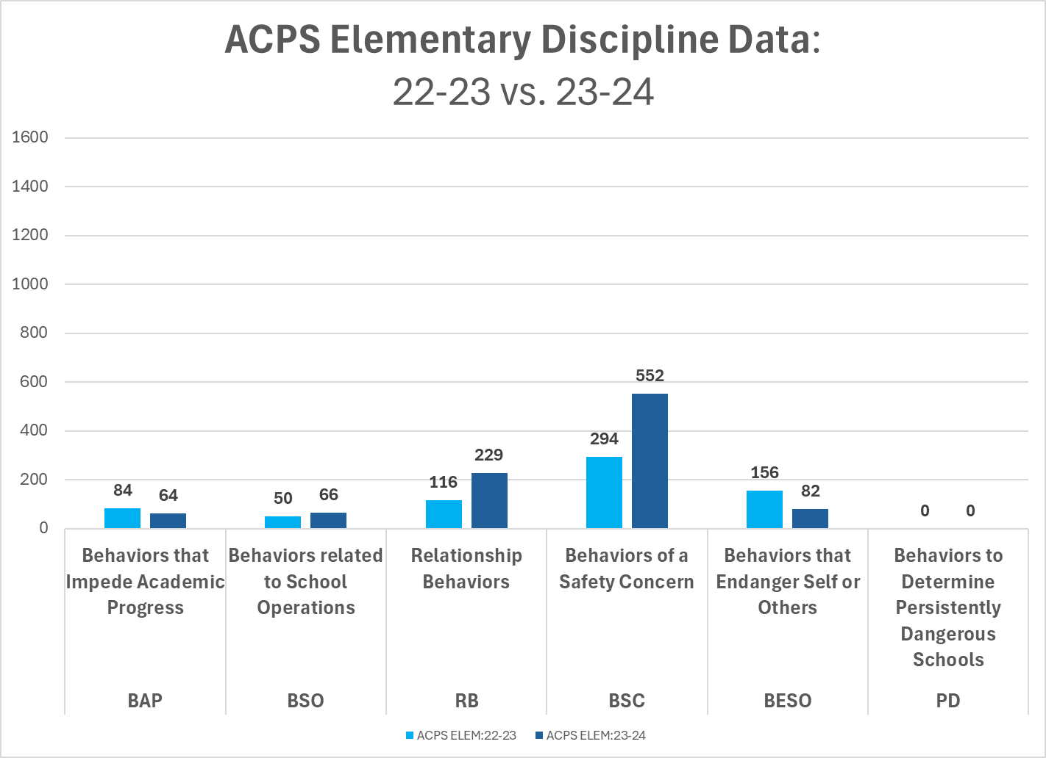

Slide 8
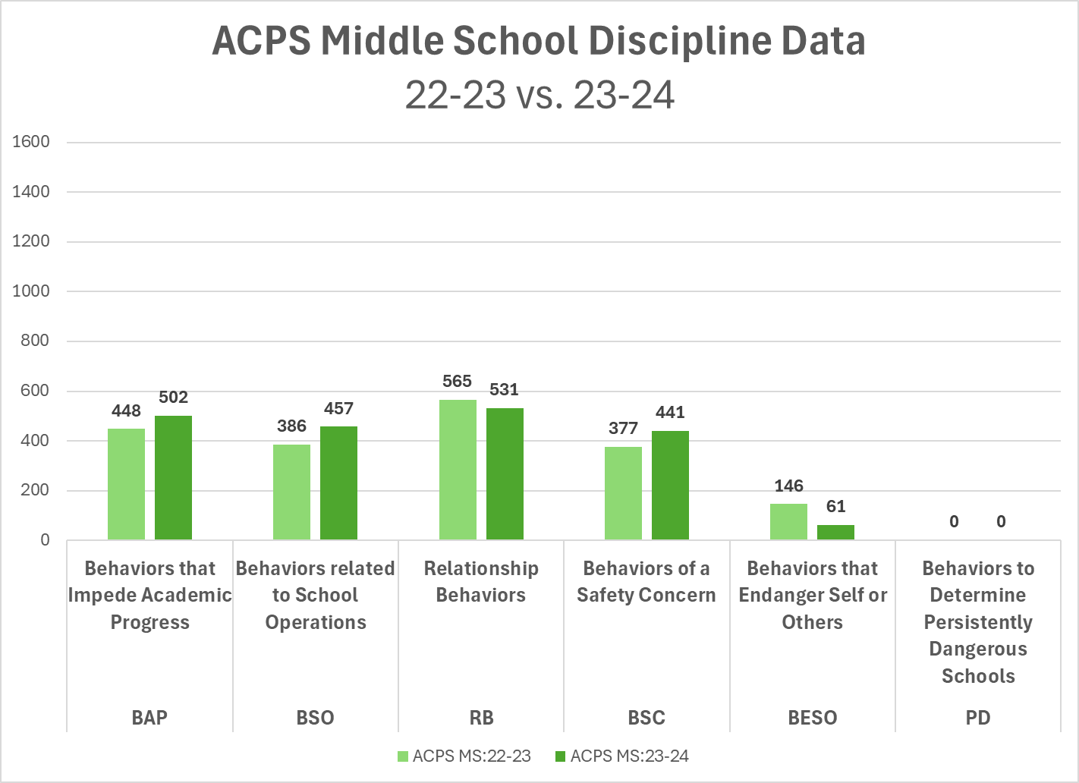

Slide 9
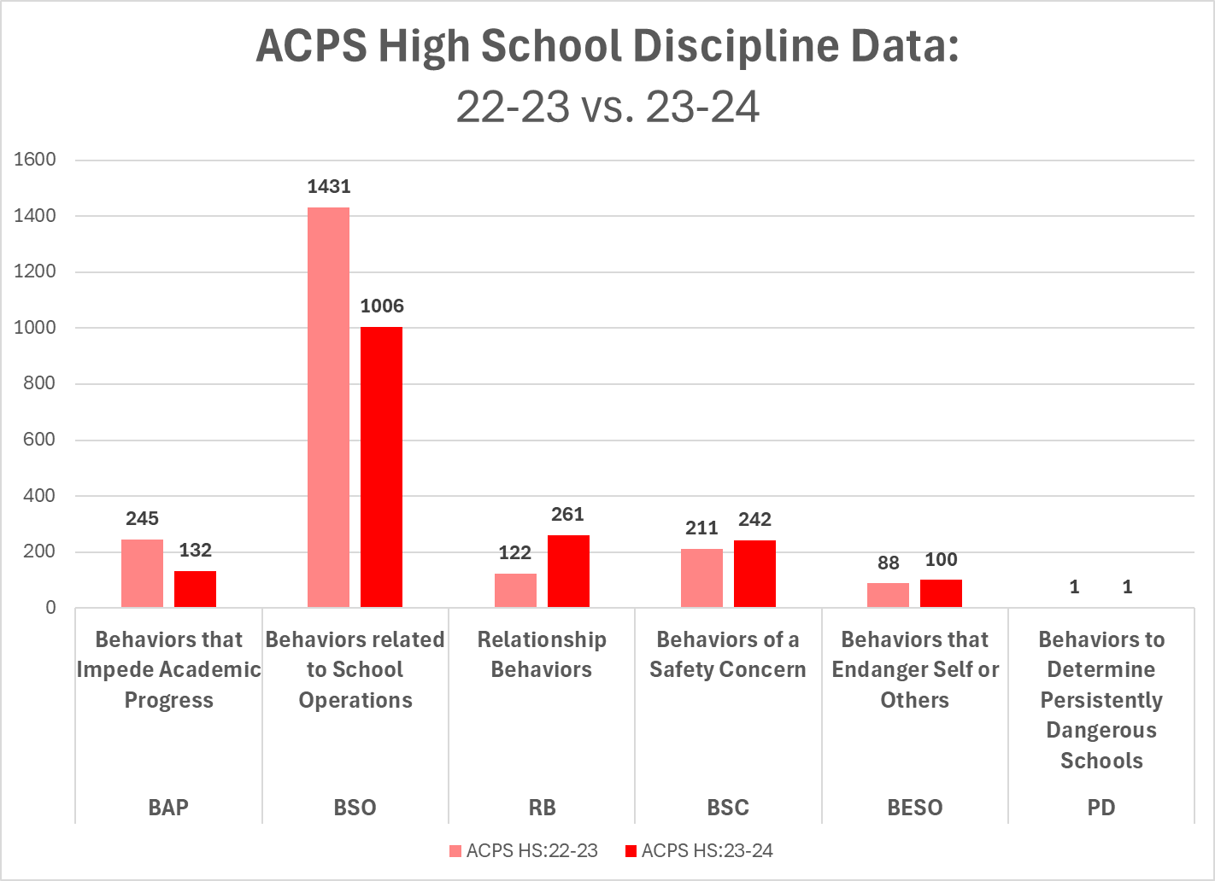

Slide 10
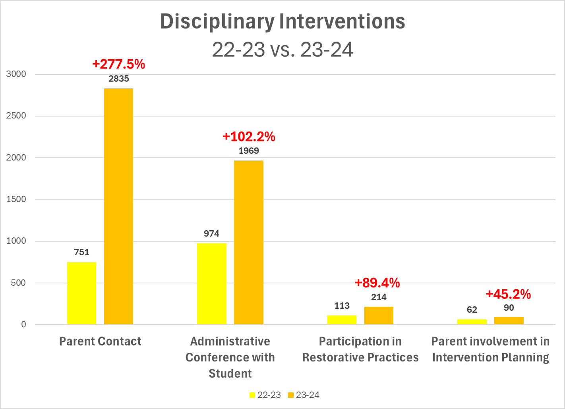

Slide 11
SUMMARY of DISCIPLINE DATA
Virginia is seeing increases in all disciplinary categories with exception of a decrease in Persistently Dangerous Behaviors.
Albemarle County Schools is seeing mixed results.
  Elementary and Middle School are having challenges dealing with increased behavior challenges.
  High School making gains or holding data.
  Persistently Dangerous Behaviors - no change.
Intervention data indicate increases in positive and engaging practices.

Slide 12
Questions/Discussion

