Slide 1


Training and Resources in ACPS

Slide 2
Agenda
1
What is HELPme
The “why” behind the shift from Anonymous Alert to HELPme
3
Trainings & Resources for HELPme
Additional trainings, communications, podcast, and materials supplied for or requested by school staff.
2
Implementation Timeline
A full timeline of our solicitation to implementation of HELPme
4
A video example of a HELPme Alert
A quick video example of what HELPme looks like on the staff and student side.
Notes:
Good evening. Today, I’d like to discuss the transition from Anonymous Alerts to the new HELPme system. To begin, I think it’s essential to focus on the 'why'—the reasoning behind this change and the benefits it brings to our schools and students."
In the second part of the presentation, we’ll delve into our implementation process. I’ll walk you through the steps of our solicitation efforts and how we’re prepared to train both staff and students for this shift in services.
Next, we’ll explore the training and resources we’ve developed to support awareness and implementation of the HELPme system. These efforts are designed to benefit both students and staff as we continue to prioritize their preparedness and understanding.
Lastly, we’ll conclude today with a video example of what a HELPme alert looks like in action. This demonstration is important for transparency, ensuring everyone understands that HELPme alerts are handled internally by our school staff, not outsourced to an external entity. I’ll also address some feedback we’ve received about this misconception to clarify how the system works and who is involved.

Slide 3
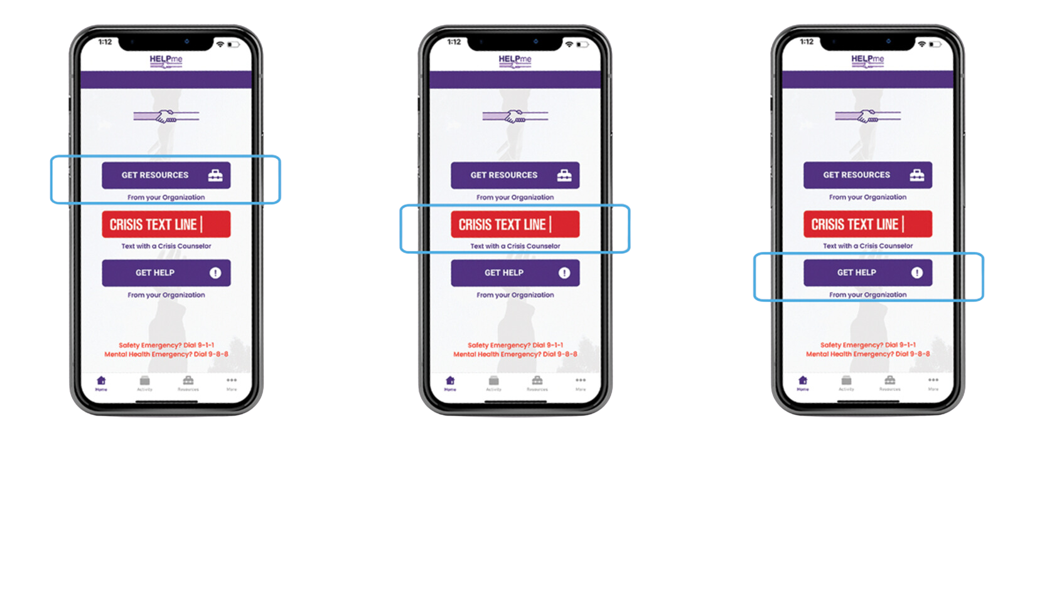
What is HELPme
Notes:
The decision to move from Anonymous Alerts to HELPme was intentional and rooted in the purpose behind it. When we used Anonymous Alerts, it was often referred to—perhaps unkindly—as our "snitch line." Many of the reports submitted through that system included statements like, "I need you to take care of this" or "I need you to do this to someone," without fostering skills or contributing to building our community.
During our solicitation process, HELPme stood out because it fundamentally shifted the focus from "what you can do for me" to "how can we support one another?" This shift aligns with our commitment to building a stronger, more collaborative community. Whether through academic content or social-emotional learning, HELPme supports our efforts to teach and reinforce the skills necessary for a supportive environment.
Since adopting HELPme, the quality of information shared and how it is presented to staff has significantly improved. Unlike the one-way communication of Anonymous Alerts, HELPme enables two-way interaction. Every alert received allows for follow-up—whether to request additional details or to express gratitude for the information shared. This back-and-forth communication ensures administrators and counselors can effectively address concerns.
HELPme alerts are first reviewed by our administrators, who act as the initial point of contact. The system is designed to categorize alerts and route them to the appropriate individual. For example:
Self-harm concerns: These are routed to a counselor who checks in with the student and follows up with their family.
Bullying concerns: Typically handled by the administrator who follows up directly with the student.
Addressing third-party involvement and after-hours monitoring
We also recognize the importance of supporting our administrators without asking them to be on call 24/7. To address this, HELPme includes an after-hours monitoring service. From 4 PM to 7 AM, the HELPme team reviews alerts for imminent concerns, such as situations where someone might be in immediate danger.
When necessary, they escalate these concerns back to ACPS. Currently, three individuals are on call to receive these escalations: myself, Darah Bonham, and Craig Zottola. Once we receive an alert, we either contact the family directly or coordinate with the administrator to ensure the situation is addressed.
In more serious cases, such as threats involving school safety (e.g., Snapchat posts about potential school shootings), we work closely with our ACPS partners, including law enforcement, to ensure swift action.

Slide 4
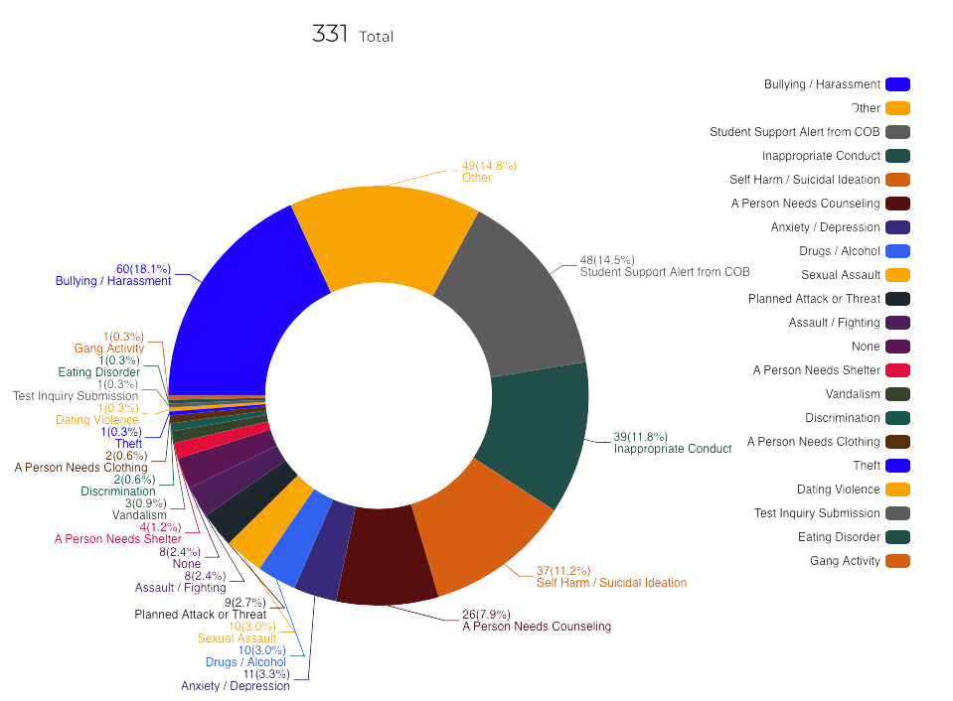

HELPme Utilization Data
Total Alerts: 434
Verified Alerts: 331
Notes:
Here’s an overview of our HELPme alerts for the year. So far, we’ve received a total of 434 alerts. Of those, 331 were verified alerts. This distinction is significant because it highlights the educational opportunities that come with these reports.
Every alert goes directly to administrators, and we thoroughly review each one. However, it’s crucial to emphasize the importance of providing complete and detailed information—such as the who, what, when, and where—so we can fully investigate and follow up.
Some alerts cannot be acted upon due to missing or incomplete information. For instance, we occasionally receive reports about a scenario but lack identifying details like a name or sufficient context to determine who is involved. This can prevent us from offering the resources and support needed.
That’s why we encourage everyone—students, staff, and community members—to be as detailed as possible when submitting HELPme alerts. Clear, complete information allows us to respond effectively and provide the necessary assistance to those in need.
A great example of this is when we receive information about potential school threats on platforms like Snapchat. Sometimes, we get a HELPme alert that simply states, 'There was a threat on Snapchat,' but no further details are provided—no screenshots, usernames, or additional context.
In cases like this, especially when it involves potential school violence, having detailed information is critical. The more information you can provide—such as screenshots or usernames—the better equipped we are to work with the Office of School Safety and Security to assess the situation and take appropriate action. This partnership is essential to ensuring the safety of our entire school community.
It’s also important to emphasize that we don’t want to discourage anyone from reporting information they have, even if it’s just a rumor. If all you’ve heard is a rumor, please still submit a HELPme alert and clearly state that it’s all the information you currently have.
At the same time, it’s helpful to understand that additional details—such as specific names, times, or screenshots—are often necessary for us to thoroughly investigate and address the situation. Even partial information is valuable and can sometimes lead us to uncover more through follow-up, so please don’t hesitate to report what you know

Slide 5


Implementation Time Line for HELPme
JAN 24
FEB 24
MAR 24
APR 24
Submitted RFP to Solicit bids for a student Reporting System
ACPS panel reviewed all RFPs
Proposals sent to ACPS
Interviewed final propsals
AUG 24
JUL 24
JUL 24
Leadership retreat training for Admin Staff
Introduction Email to administrative staff about HELPme
Contract Finalized and Implementation with ACPS IT Dept
AUG 24
AUG 24
AUG 24
SEP 24
Marketing materials provided to each and every ACPS school and program
Provided template for middle and high school advisory lesson
Community messages sent out to all ACPS Families
Pre-Service week training for all Administrators and SBMH Staff
Notes:
This slide outlines our implementation timeline for HELPme. Every few years, we are required to review our current contracts, and 2024 was a review year for Anonymous Alerts. In January 2024, we initiated a solicitation process to explore what services could be offered for a system like Anonymous Alerts.
The timeline began with accepting proposals and convening a review panel, which included administrators, school counselors, Central Office staff, technology staff, and members of the Department of School Safety and Security. We started early to ensure ample time for implementation; however, finalizing the contract took longer than anticipated. The contract was not signed until the second week of July.
From there, we collaborated with the Technology Department to set up the system, including single sign-on integration, to make it as seamless as possible for administrators to access and use its features. This work led us into August, where HELPme was first introduced during our Leadership Retreat with all school administrators.
During pre-service week, we provided comprehensive training for all staff involved with HELPme. This included school administrators, school counselors, mental health support specialists, and safety coaches. The training covered system access, key features, and the alert response process to ensure everyone was prepared to utilize HELPme effectively.
Now, moving to the next slide, I’ll highlight the ongoing efforts we’ve made to ensure HELPme is well-integrated and recognized within our community

Slide 6
Additional Trainings & Resources
  School Community Sessions (9/25/24) Presented with the Office of Community Engagement during the September Back to School Community Sessions (9/25/24)
  Engage ACPS Podcast
    Student Mental Health Matters! HELPme, ACPS Resources (12/10/24)
    School Safety & Security (9/11/24)
    Student Mental Health (Part 1) “HELPme” Student & Family Resources (8/26/24)
  Community Messaging
    Enhancing School Safety & Support: Introducing HELPme and Lightspeed Alert (8/19/24)
    ACPS Supports: How We Work to Keep Your Students Safe (9/5/24)
    ACPS Supports: Important Safety Message (9/12/24)
    Join Our Back-to-School Info Session on September 25 (9/17/25)
  Social Media Post on 8/25, 9/13, and 12/6
  Presented to Student Senate on 10/18/24
  Staff Trainings:
    Trained all Administrators & School Based Mental Health Support Staff (Aug 2024)
    Site based School Trainings:
      7 schools requested additional trainings
    Title IX staff Training on HELPme
    LTI Staff Training on HELPme to support students and staff
    TSS Staff Training on HELPme to support technical use of HELPme
  Internal resources website created for staff to access marketing materials & training videos
  September Connections message from Dr. Hass to Introduce HELPme
Notes:
The Department of Student Services has provided over 23 hours of training to staff, and you can see the breakdown of these trainings under the 'Staff Trainings' section. I’d also like to highlight the internal resource site we developed specifically for staff. This site includes materials and training videos that are always accessible, recognizing the time constraints educators face in their day-to-day responsibilities.
Additionally, I’d like to acknowledge the efforts that have gone into promoting HELPme. In September, when school began, Dr. Haas introduced HELPme to the school community through the September Connections newsletter. I’d also like to thank the Communications Department for sharing multiple messages about HELPme with families and students.
We partnered with the Department of Community Engagement, which allowed me to discuss HELPme in greater depth through platforms like the Engage ACPS podcast. I also had the privilege of speaking about HELPme during the Back-to-School Community Info Session, where it was highlighted as a key resource for our community. Beyond that, we’ve utilized social media to spread awareness and engaged directly with students to discuss HELPme and its features.
In my conversations with students, I’ve noticed that some were not yet familiar with HELPme, which underscores the importance of continued outreach and education. Moving forward, I’m excited about the opportunity to involve students more directly. We’re currently working with the Office of Community Engagement to explore how students can partner with the Department of Student Services and the Communications Department to create training videos tailored for their peers. This collaboration would ensure that student voices are central to our messaging and materials—a step I’m particularly excited about.
Now, to provide a more concrete example, I’d like to introduce Mr. Josh Walton, Principal of Walton Middle School. He will share how his school has trained students to use the HELPme system, offering you a glimpse of what this looks like in practice

Slide 7
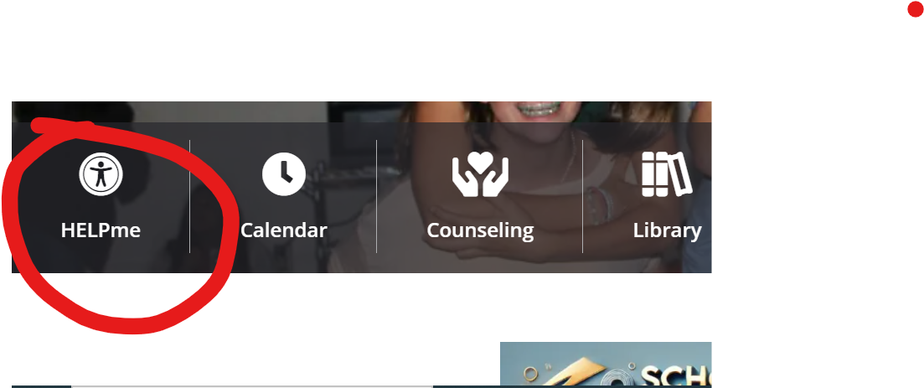
SCHOOL BASED TRAININGS FOR STUDENTS
HELPme
Use appropriately. This is a resource to help you help yourself and others.
Be an upstander for others. If you see something out of line, say something.
Reporting for safety is NOT snitching.
Please use this appropriately, this is for serious concerns only. Concerns can always be reported to counselors and the office.

Slide 8
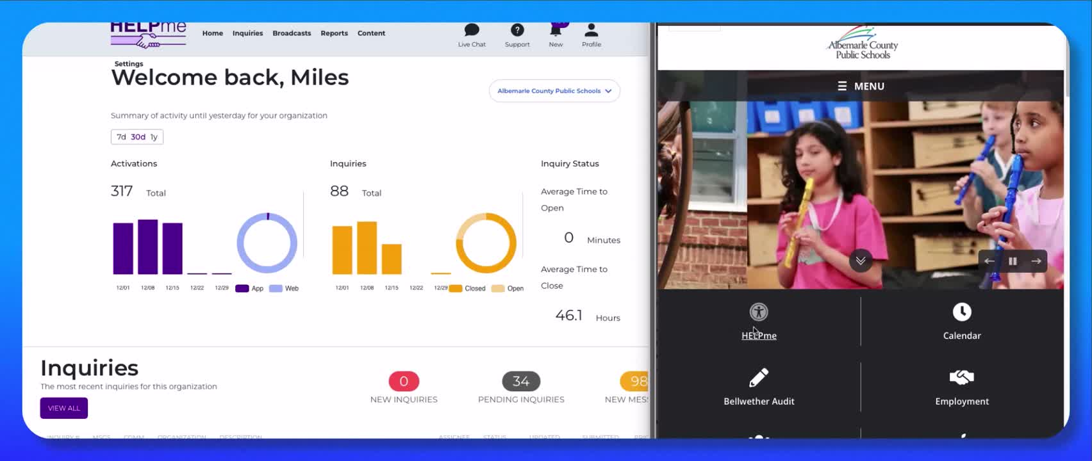
Quick Video Walkthrough for a Helpme Alert
Notes:
https://drive.google.com/file/d/14T2Gb1p5bLvq5gm5BsyDkzDyhwQqQygX/view?usp=drive_link

Slide 9
Questions/Discussion
Notes:
we want to emphasize that this system is a collaborative effort. We value the voices of our students and are committed to continuously improving HELPme to meet their needs. Your feedback is vital to this process, and we welcome ideas on how we can enhance the system to ensure it remains effective, supportive, and responsive for everyone.

